Slide 1
Chap-05:Distributed Databases
Prof. Ramesh D Jadhav (SIOM)

Slide 2
Chap-05: Distributed Databases
5.1 Introduction to Distributed Database System.
5.2 Homogeneous and Heterogeneous Databases.
5.3 Distributed data storage (Fragmentation and Replication)
5.4 Distributed transactions
5.5 Concurrency control schemes in DDBMS
5.6 Commit protocols 2 phase and 3 Phase Commit Protocol
Extra Reading :Reliability issues in DDBMS and Web based interface of DDBMS

Slide 3
5.1 Introduction to Distributed Database System.
During the 1970s corporations implemented centralized database management system to meet their structured information need- structured information is usually presented as regularly issued formal reports in a standard format.
The 1980s crucial social and technological changes that affected database
- Business operation became more decentralized geographically
- Competition increased at the global level
- Customer demands and market need favored a decentralized management style
- Rapid technology changed create low cost microcomputers
with mainframe-like power
-The large number of application based on DBMS.
During the 1990s the factors we have just described became even more firmly interchanged.
-The growing acceptance of the internet and particularly the World wide web, web site , e-commerce , Mobile technology.
Notes:
Chapter Name
September 98

Slide 4


5.1 Introduction to Distributed Database System.
(Cont.. )
Centralized Systems
  Centralized systems have non-autonomous components
  Centralized systems are often build using homogeneous technology
  Multiple users share the resources of a centralized system at all times
  Centralized systems have a single point of control and of failure
Distributed Systems
  Distributed systems have autonomous components
  Distributed systems may be built using heterogeneous technology
  Distributed system components may be used exclusively
  Distributed systems are executed in concurrent processes
  Distributed systems have multiple points of failure

Slide 5
5.1 Introduction to Distributed Database System.
(Cont.. )
A distributed database (DDB) is a collection of multiple, logically interrelated databases distributed over a computer network.
A distributed database management system (D–DBMS) is the software that manages the DDB and provides an access mechanism that makes this distribution transparent to the users.
A distributed database system is a collection of logically related databases that co-operate in a transparent manner.
Transparent implies that each user within the system may access all of the data within all of the databases as if they were a single database
There should be ‘location independence’ i.e.-as the user is unaware of where the data is located it is possible to move the data from one physical location to another without affecting the user
Notes:
Chapter Name
September 98

Slide 6
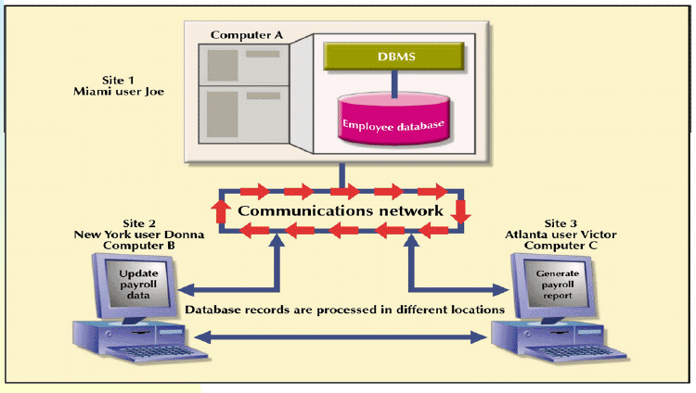
5.1 Introduction to Distributed Database System.
(Cont.. )
I) Distributed processing share the database’s logical processing among two or more physically site that connected through a network
Distributed processing Environment

Slide 7
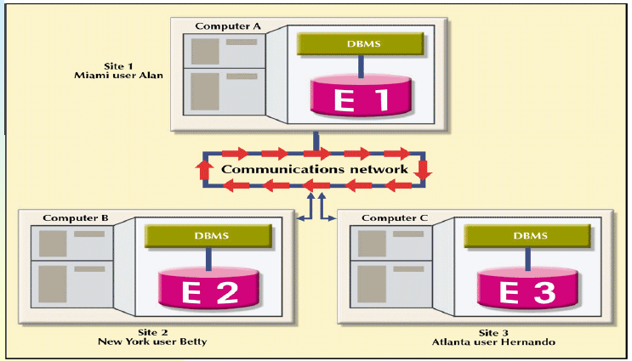
II) Distributed database:- The stores a logically related database over two or more physically independent sites. The sites are connected via a computer network. In a distributed database system a database is composed of several parts known as data fragments the database fragments are located at different sites.
5.1 Introduction to Distributed Database System.
(Cont.. )
Distributed Database Environment

Slide 8
5.2. Homogeneous and Heterogeneous Databases.
Fully distributed database management system with support for multiple data processors and transaction processors at multiple sites .Depending on the level of support for different types of centralized DBMS .DDBMSs are Classified as either homogeneous or heterogeneous
Homogeneous DDBMSs
Integrate only one type of centralized DBMS over a network thus the same DBMS will be running on different mainframes, minis and microcomputers.
Heterogeneous DDBMSs
Integrate different types of centralized DBMSs over a network

Slide 9
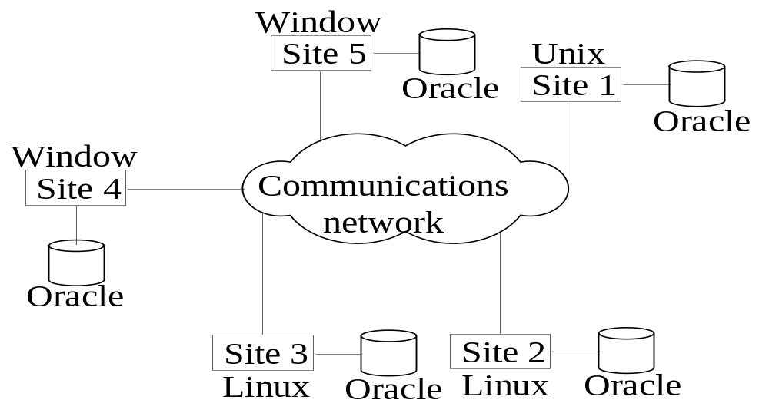
5.2. Homogeneous and Heterogeneous Databases.
(Cont..)
Fig. Homogeneous Database

Slide 10
5.2. Homogeneous and Heterogeneous Databases.
(Cont..)
1)Homogeneous system-Common Database Software.
2)Homogeneous system are easier to design & can be managed
3) Database schema is same on all database(structure)
4)Improved performance due to the parallel execution of query processing
5) Identical software are used in all site
6) Identical hardware configuration are used in all the sites
Notes:
Chapter Name
September 98

Slide 11
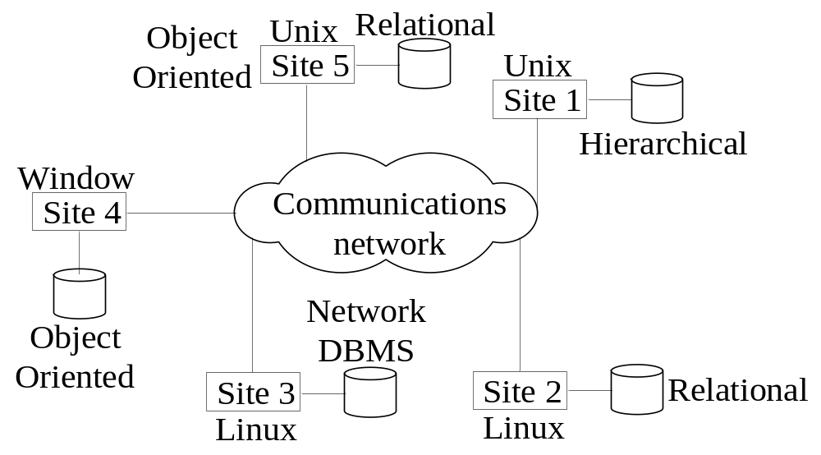
5.2. Homogeneous and Heterogeneous Databases.
(Cont..)
Fig. Heterogeneous Databases

Slide 12
5.2. Homogeneous and Heterogeneous Databases.
(Cont..)
1) Different sites use different Database Software.
2)Heterogeneous system are difficult to design & can be managed.
3)Database schema is different on all database software.
4) Improved performance is not easy (due to data partitions and the structure of database reside in different site may be different
5) Different software are used in all sites.(operating system)
6) Different hardware configuration used in all the sites.

Slide 13
5.3 Distributed data storage (Fragmentation and Replication)
Data fragmentation:
How to partition the database into fragments
Data replication:
Which fragments to replicate
Data allocation:
Where to locate those fragments and replicas

Slide 14
5.3.1 Data fragmentation
Breaks single object into two or more segments or fragments
Each fragment can be stored at any site over a computer network
Information about data fragmentation is stored in the distributed data catalog (DDC), from which it is accessed by the TP/TM to process user requests
Data Fragmentation Strategies
Horizontal fragmentation: Division of a relation into subsets (fragments) of tuples (rows)- This is equivalent SELECT with the WHERE clause.-(Selection)
Vertical fragmentation: Division of a relation into attribute (column) subsets -This is equivalent PROJECT statement.
Mixed fragmentation: Combination of horizontal and vertical data fragmentation strategies

Slide 15
5.3.1 Data Fragmentation Strategies
Row
Selection
Horizontal fragmentation
Projection
Vertical fragmentation
Join
Mixed fragmentation

Slide 16


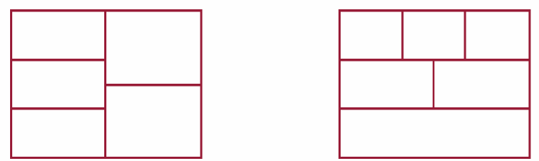
5.3.1 Data Fragmentation Strategies
(a) Horizontal Fragmentation
(b) Vertical Fragmentation
(c) Mixed Fragmentation

Slide 17
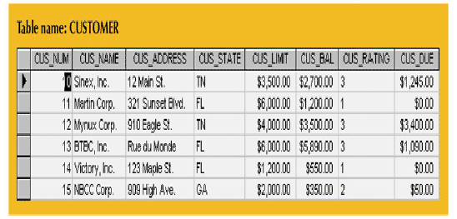
5.3.1 A Sample CUSTOMER Table

Slide 18
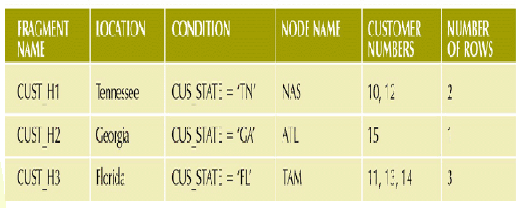
5.3.1 Horizontal Fragmentation of the CUSTOMER Table by State (Example)
Suppose company corporate management required information about its customer in three states but company location in each state TN, FL and GA
Notes:
Chapter Name
September 98

Slide 19
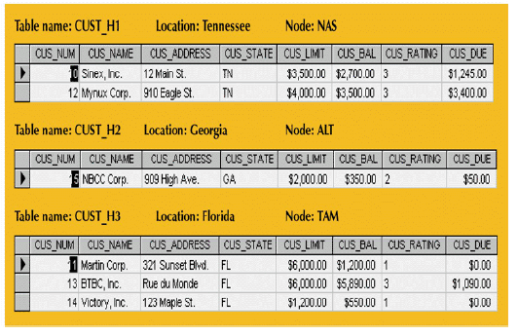
5.3.1 Table Fragments in Three Locations
Each horizontal fragment may have a different of rows but each fragment must have the same attributes.

Slide 20
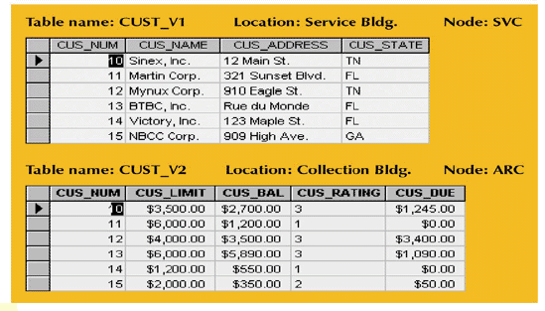
5.3.1 Vertically Fragmented Table Contents
Suppose the company is divided into two departments the service department and collections department

Slide 21
5.3.1 Mixed Fragmentation
The company required that customer data be fragmented horizontally to accommodate the different company location with in location that must be fragmented vertically to accommodated the different department –service and collection
Mixed fragmentation required a two step
Horizontal fragmentation for each site- location & state wise
Department are located in different building we use vertical fragmentation

Slide 22
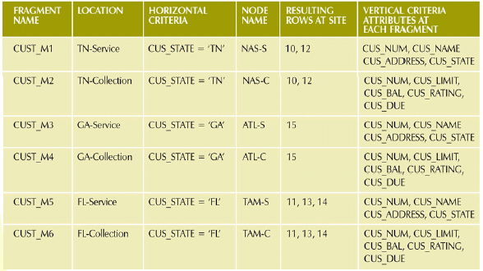
5.3.1 Mixed Fragmentation of the CUSTOMER Table

Slide 23
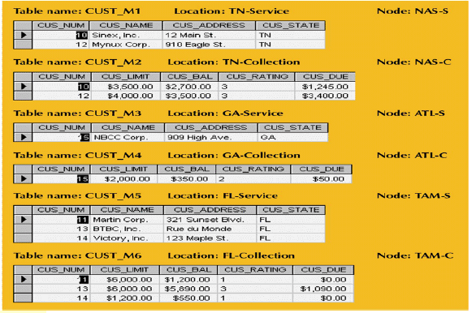
5.3.1 Mixed Fragmentation of the CUSTOMER Table
Table Contents after the Mixed Fragmentation Process

Slide 24
5.3.2 Data Replication
Replication
  System maintains multiple copies of data, stored in different sites, for faster retrieval and fault tolerance.
Replication and fragmentation can be combined
  Relation is partitioned into several fragments: system maintains several identical replicas of each such fragment stored in distinct sites.
A fragment of a relation is replicated if it is stored redundantly in two or more sites.
  Full replication of a relation is the case where the relation is stored at all sites.
  Fully redundant DB means every site contains a copy of the entire DB.

Slide 25
5.3.2 Advantages & Disadvantages of Replication
Advantages of Replication
Fragment copies can be stored at several sites to serve specific information requirements can
1) Enhance data availability and response time.
2)Can help to reduce communication and total query costs,
3)Parallelism- several nodes in parallel.
Disadvantages of Replication
  Increased cost of updates: each replica of relation must be updated.
  Increased complexity of concurrency control: concurrent updates to distinct replicas may lead to inconsistent data unless special concurrency control mechanisms are implemented.

Slide 26
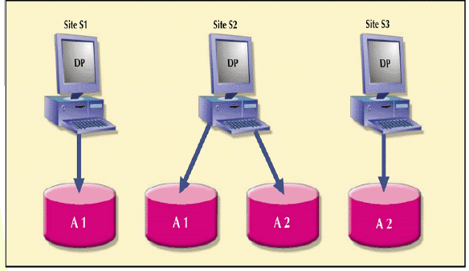
5.3.3 Data Replication
Fig. Data Replication

Slide 27
5.3.3 Data Allocation
Deciding where to locate data allocation strategies:
Centralized data allocation: Entire database is stored at one site
Partitioned data allocation: Database is divided into several disjointed parts (fragments) and stored at several sites
Replicated data allocation: Copies of one or more database fragments are stored at several sites Data distribution over a computer network is achieved through data partition, data replication, or a combination of both Data allocation is closed related to the way a database is divided or fragmented

Slide 28
References Books
1) Database system concepts- Silber Schatz, Korth, Sudarshan
2) Database system-A Practical Approach to design Implementation and Management- Thomas Connolly, Carolyn Begg

